Slide 1


Green Pace
Security Policy Presentation
Developer: Matthew Clockel

Slide 2

OVERVIEW: DEFENSE IN DEPTH
Here is a model of cyber security and the defense in depth illustration. The defense in depth helps keep critical assets and data secured. Each layer provides a hurdle for an attack. Each layer must be taken down to access the assets. The more layers and diversity of layers the less vulnerable.

Slide 3
THREATS MATRIX
Likely high severity of attacks to happen | Priority High number priorities have higher severity levels
Low priority Expensive to repair but low exploitable vulnerability | Unlikely Low severity of attacks to happen
Priority and levels show the severity, likelihood, and remediation costs. The threat matrix prioritizes threat levels.

Slide 4
10 PRINCIPLES
1. Validate input
2. Heed compiler warnings
3. Architect and design for security policies
4. Keep it simple
5. Default deny
6. Adhere to the principle of least privilege
7. Sanitize data sent to other systems
8. Practice defense in depth
9. Use effective assurance techniques
10. Adopt a secure coding standard

Slide 5
CODING STANDARDS
1. Do not define a C-style variadic function
2. Do not declare or define a reserved identifier
3. Never qualify a reference type with const or volatile
4. Do not write syntactically ambiguous declarations
5. Overload allocation and deallocation functions as a pair in the same scope
6. Avoid information leakage when passing a class object across a trust boundary
7. Avoid cycles during initialization of static objects
8. Do not let exceptions escape from destructors or deallocation functions
9. Do not modify the standard namespace
10. Do not define an unnamed namespace in a header file

Slide 6
ENCRYPTION POLICIES
Encryption At Rest – Stored data this is protected by software or firewalls. This stored data is encrypted which helps prevent a hacker from accessing the data.
Encryption At Flight – The data being sent is protected by encryption. This will provide protection from vulnerabilities such as man in the middle attacks.
Encryption In Use – Data is secured at rest, in flight, or in use. This ensures confidence in security when transmitting, storing, or using data.

Slide 7
TRIPLE-A POLICIES
Authentication – This is a way to identify users with credentials to ensure proper access. This is usually done with a user login and password or other authentication ways such as biometrics.
Authorization – Allows the user to perform what they are authorized to access based on their access level. Users can create, read, update, or delete data based on their access level.
Accounting – Monitors and Measures the resources users are using when accessing in the system.

Slide 8
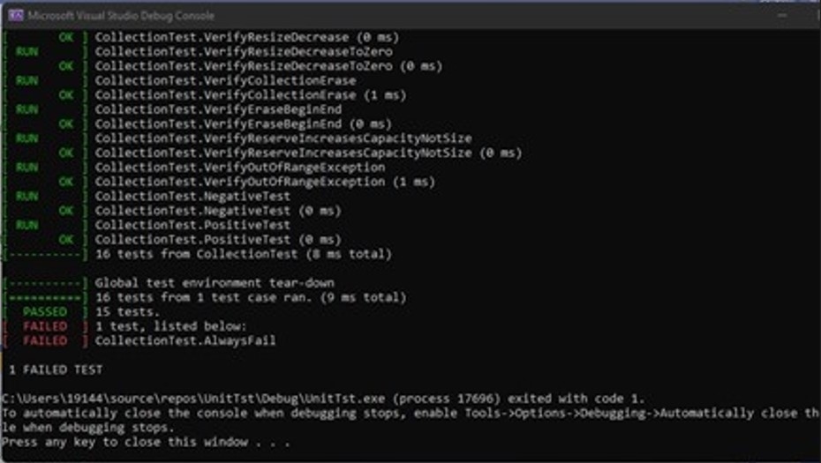
Unit Testing
Unit testing helps limit vulnerabilities within software. Buffer overflow unit test will catch an error if a user inputs more than the max character input. Limiting user input characters will prevent this type of vulnerability

Slide 9

AUTOMATION SUMMARY

Slide 10
TOOLS
The DevSecOps pipeline is integrating security and secure coding practices within the software development life cycle. This includes creating secure code and testing.
Astrée is a static code analyzer that proves the absence of runtime errors and invalid concurrent behavior in safety-critical software written or generated in C or C++. Astrée is sound — that is, if no errors are signaled, the absence of errors has been proved.

Slide 11
RISKS AND BENEFITS
The problem vulnerabilities within security. The solution is secure coding practices and a defense in depth systems. Building layers of security to reduce vulnerabilities. The risk is a cyber attack, and the benefits would be a high security build software.

Slide 12
RECOMMENDATIONS
Testing software throughout the software development life cycle will help identify gaps in the security policy.
Gaps can include:
Being unprepared to face cyber attacks.
New types of cyber attacks.
A low level of defense in depth incorporated into the software.
A less diverse defense in depth security layer.
Recommendations include:
Testing often to exploit vulnerabilities.
Secure coding best practices
A defense in depth layer that covers multiple types of attacks.
Monitoring the software

Slide 13
CONCLUSIONS
Software security has proven to be vulnerable with constant cyber attacks within society today. Incorporating secure coding principles and best practice standards in the software development Lifecyle will help reduce vulnerabilities of a cyber attack in the software.

Slide 14
REFERENCES
Seacord, R. C. (2013). Secure Coding in C and C. [MBS Direct]. Retrieved from https://mbsdirect.vitalsource.com/#/books/9780132981972/
Confluence. DCL50-CPP. Do not define a C-style variadic function - SEI CERT C++ Coding Standard - Confluence. (n.d.). Retrieved December 12, 2021, Retrieved from https://wiki.sei.cmu.edu/confluence/
display/cplusplus/DCL50-CPP.+Do+not+define+a+C-style+variadic+function.

